Slide 1
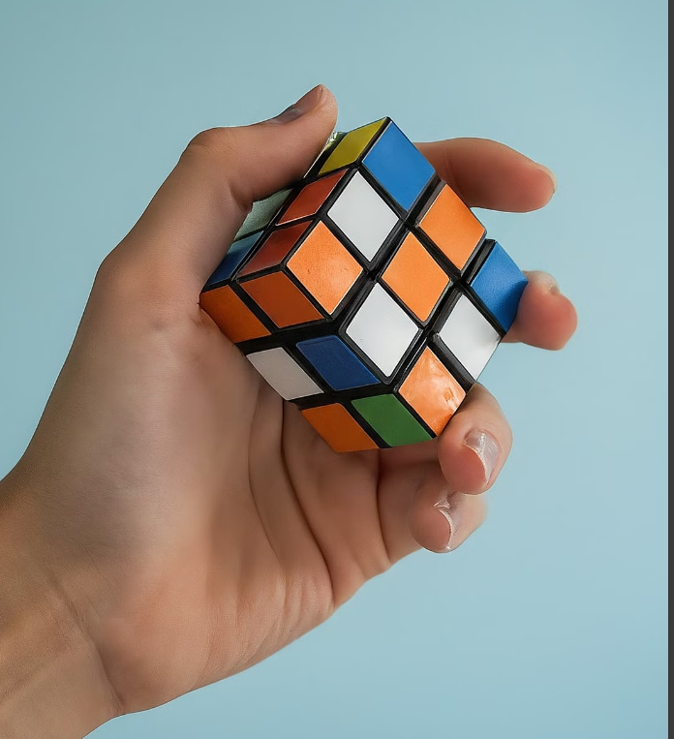
Group - 7
Pranay Gudupally
Jyothsna Priyanka Sakhamuri

Slide 2
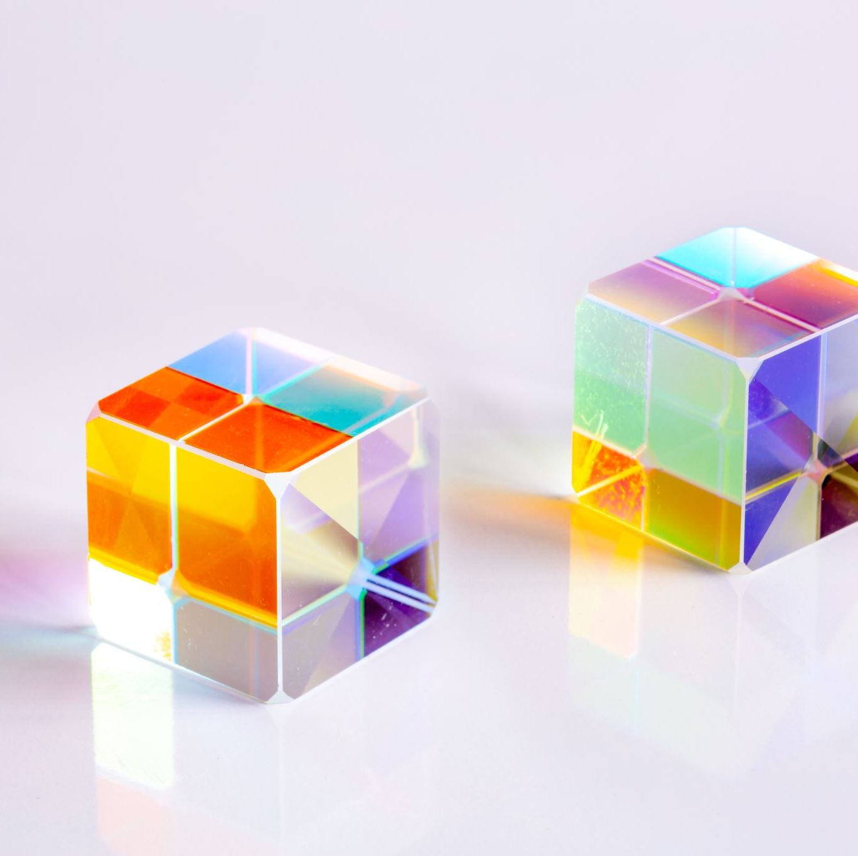
Topic:
Puzzling Perfection: Reinforcement Learning And Rubik's Cube

Slide 3

Table of Contents
Objectives
Introduction
Approach
Algorithm
Implementation
Results
Conclusion
Deliverables

Slide 4
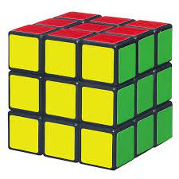
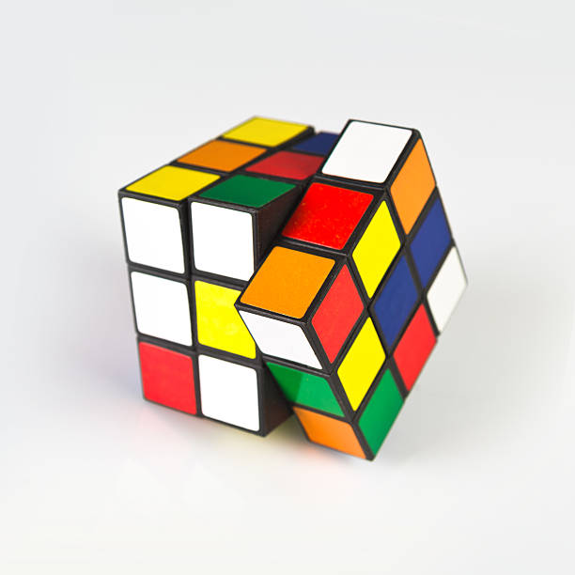
Rubik’s Cube (3*3*3)
The 3x3x3 Rubik's cube has 6 faces (front, back, left, right, top, bottom), each with 9 colored blocks.
It consists of 12 edges, 8 corners, and 6 centers.
The goal state is achieved when each side has a uniform color.

Slide 5
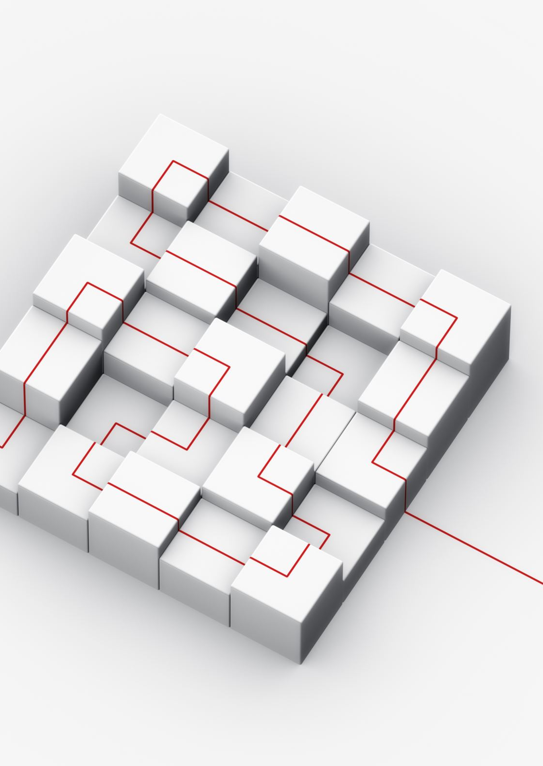
Objectives
Train an agent to autonomously solve the 3x3x3 Rubik's cube without human knowledge, using feature-based state representations.
Minimize the number of moves and solving time for efficient completion.
Develop optimal strategies through reinforcement learning.
Achieve generalization to diverse cube configurations.
Design for scalability to larger cube dimensions or similar puzzles.
Evaluate performance based on moves, time, success rate, and efficiency.

Slide 6

Approach
We have used Model-free Reinforcement Learning algorithm called Feature based Q-learning and the utilization of the pattern Database to check the quality of the nearly-finished states of the cube.
The Q-learning algorithm and epsilon-greedy policy is used to decide the optimal move based on the Q-values and the reward associated based on the discount factor in the given number of episodes with the given learning rate.
Feature-based Q learning is used by the agent to solve the cube in the given number of episodes and agent stops after reaching the goal state (Solved Cube).

Slide 7
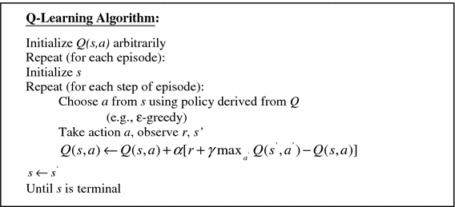
Feature based Q-learning Algorithm

Slide 8
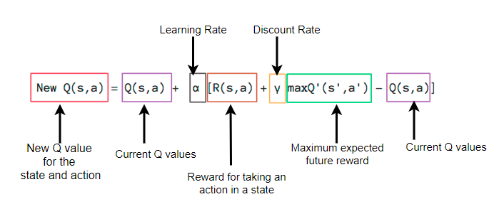
Choosing the Q-value:

Slide 9
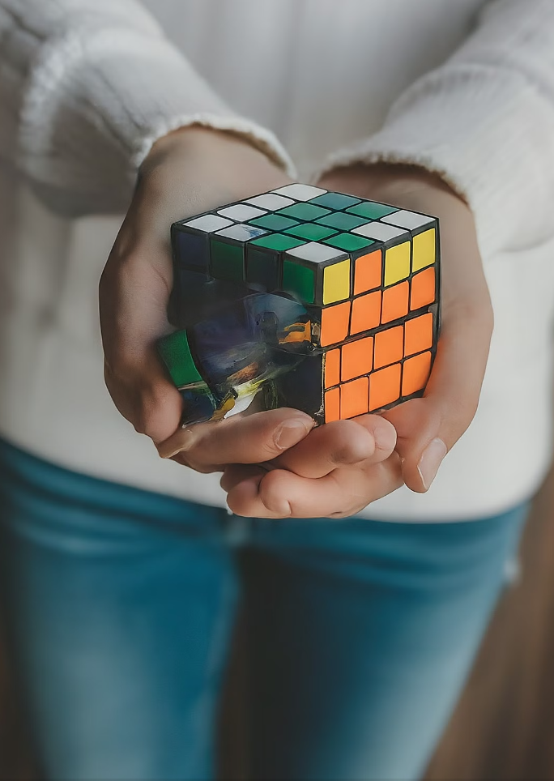
Implementation
Agent trained with the solved state as the goal.
Initialized with discount rate, learning rate, epsilon, and number of episodes.
Registered input unsolved state and assigned random Q-values initially.
Calculated Q-values at each stage and selected the best action based on maximum reward.

Slide 10
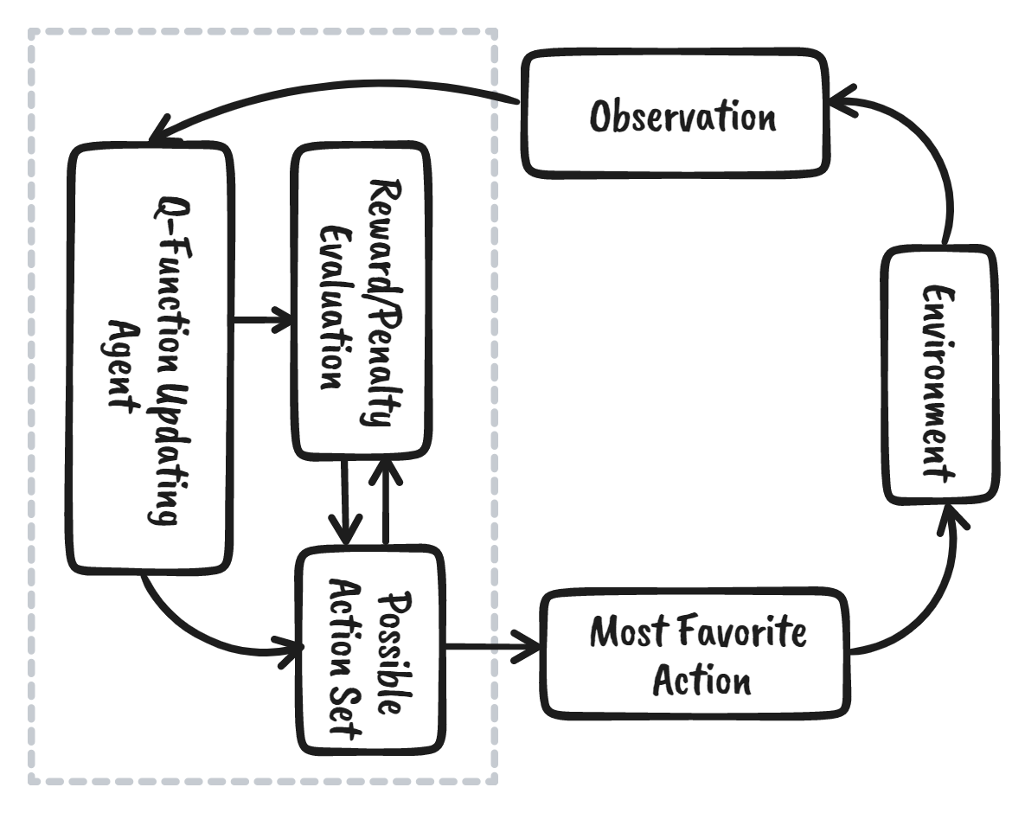
Flow Graph

Slide 11
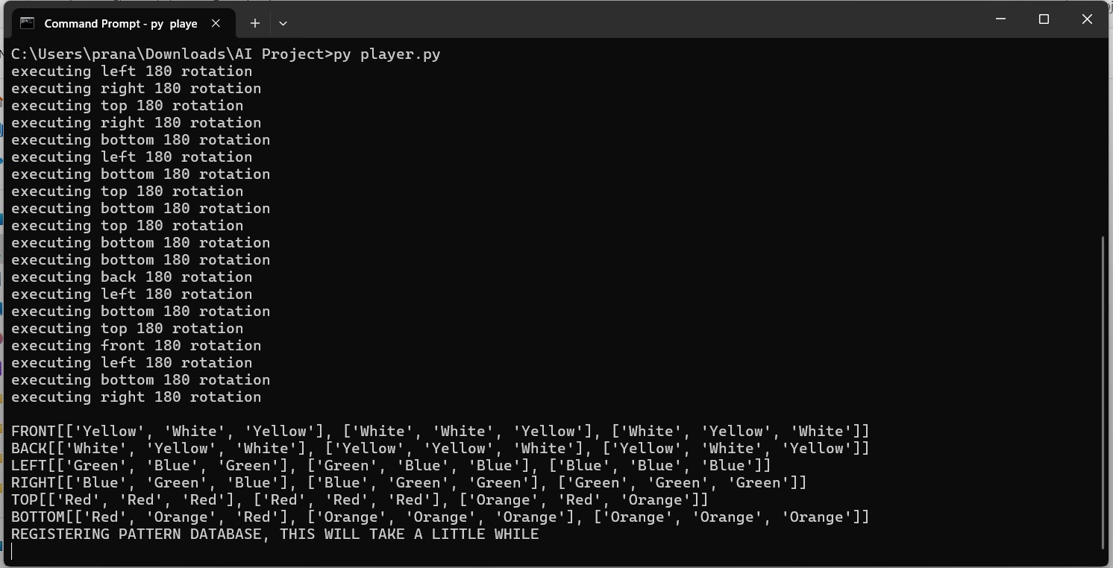
Initialized Unsolved Cube

Slide 12
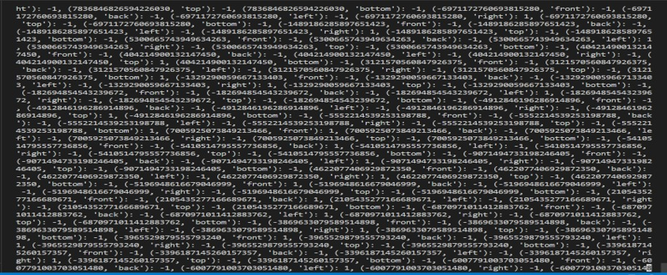
Training Stage and Calculating Q-Values

Slide 13
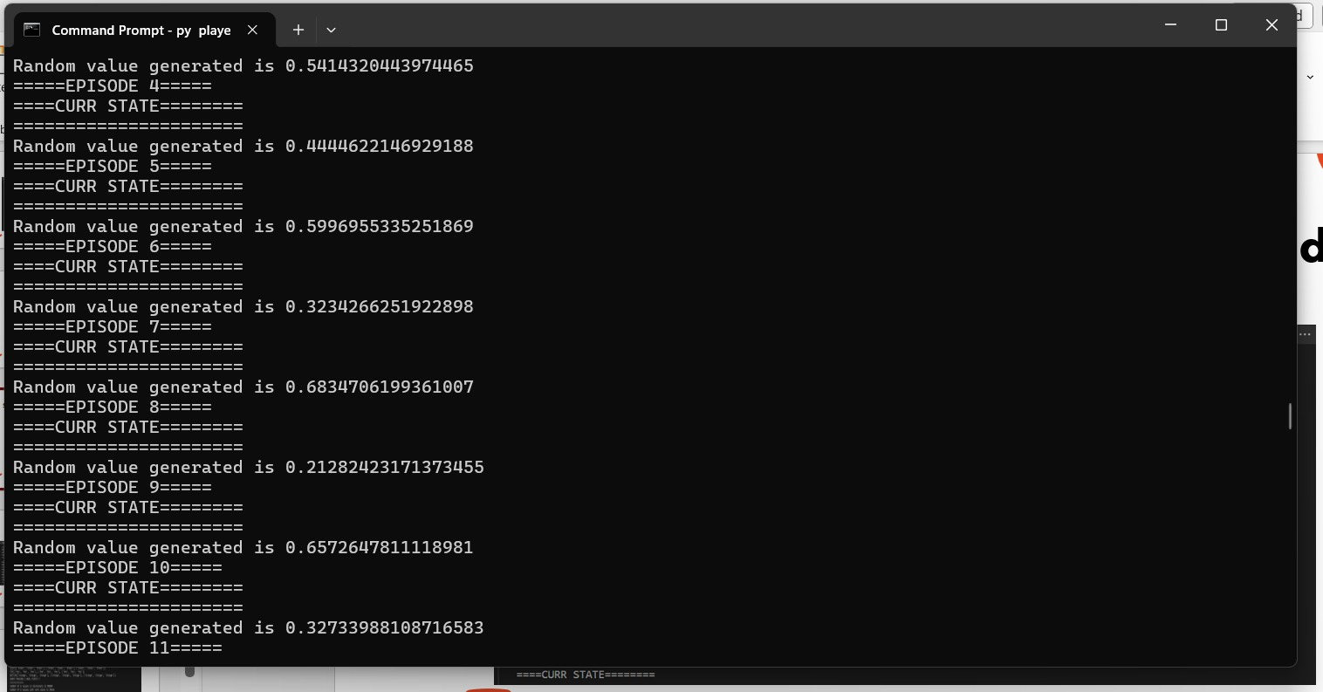
Snapshot of working in different episodes

Slide 14
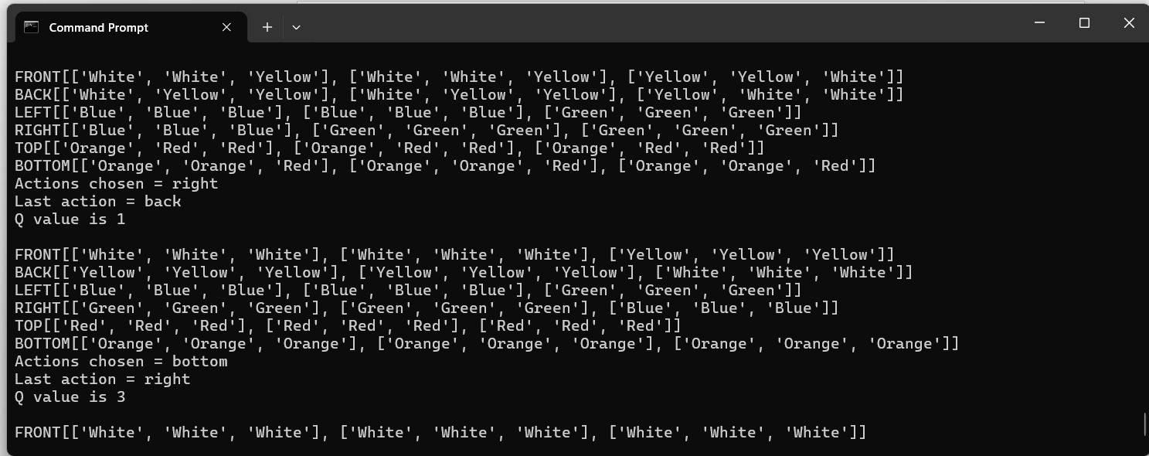
Pre-stages of Solving the Cube

Slide 15
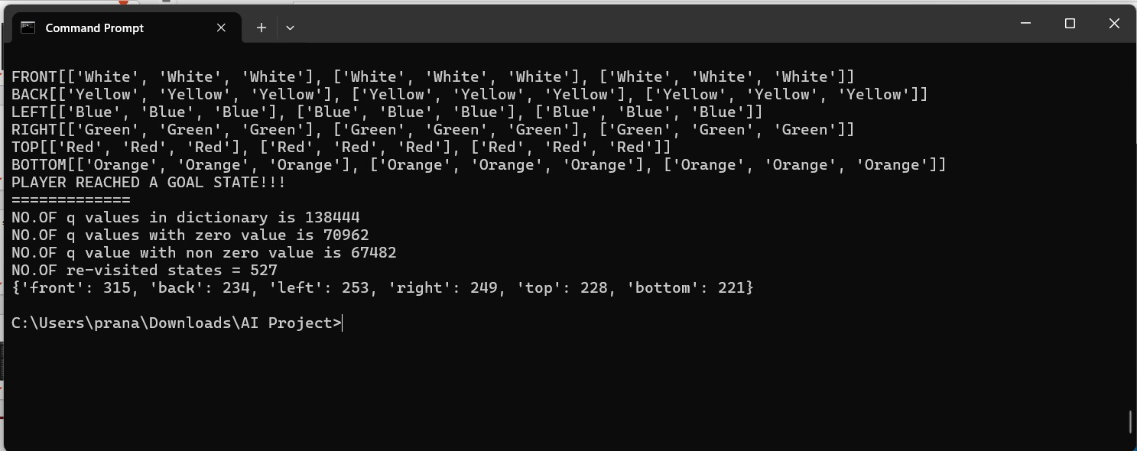
Solved Cube by the Agent

Slide 16
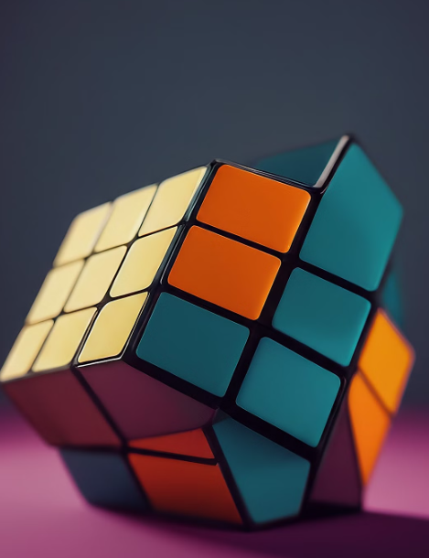
Evaluation Methodology
Reward Maximization. (Chosen the best action at each stage based on the Max Reward)
Accuracy
( 100% accuracy with <20 shuffled states)
Completion Time
(<50 seconds)
Scalability
(Works better with 4*4*4 cube too)
Complexity
Measure moves, time, success rate, and efficiency.
Scalability Testing:
Evaluate performance on larger dimensions and search spaces

Slide 17
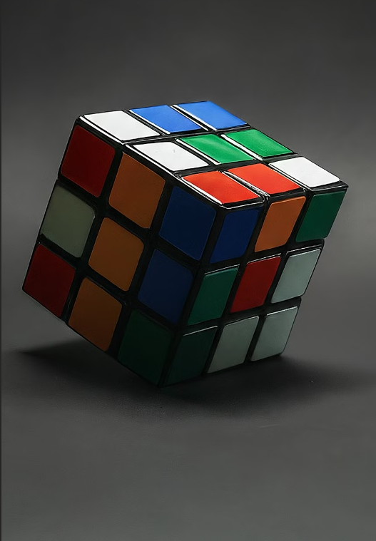
Conclusion
Choose the best action based on Q-values and maximum reward
Solved cubes with fewer than 20 shuffled states within 40 seconds.
Stopped playing after reaching the goal state (solved cube).
The agent successfully solved the 3x3x3 Rubik's cube using Feature-based Q-learning.

Slide 18



Deliverables
Code Repository
Source code for the RL agent and supporting scripts.
Data files and pre-trained models
Technical Documentation
Details on model architecture, training methodology, and algorithms
Setup and execution instructions.
Final Presentation report Project summary: objectives, approach, methodology, results
Analysis of agent's performance, strengths, and limitations
Conclusions and future work
YouTube Video
Visual showcase of the agent solving the 3x3x3 Rubik's Cube
Decision-making process and move sequence
Relevant results, statistics, and explanations

Slide 19

Thank You

